Slide 1
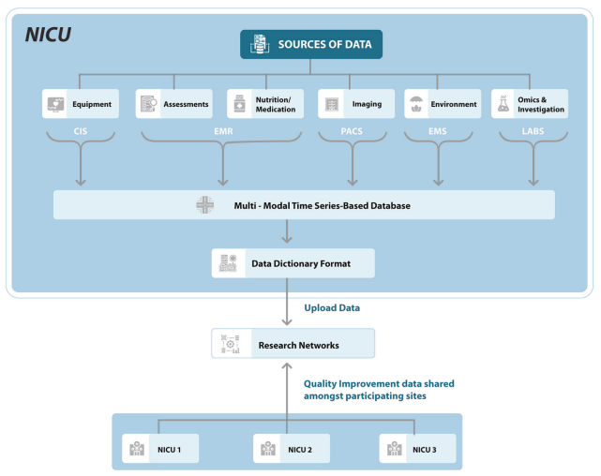
Review Paper:
Predicting clinical outcomes using artificial intelligence and machine learning in neonatal intensive care units
This paper discusses the role of artificial intelligence (AI) and machine learning (ML) in neonatal intensive care units (NICU) while also provide insights into how AI and ML can enhance predictive capabilities and improve clinical outcomes in the NICU setting

Slide 2
Introduction to AI and ML in NICU
AI in NICU involves machines learning, reasoning, and predicting clinical outcomes based on a prior knowledge or learned associations from large quantities of neonatal data.
The paper outlines various AI techniques, including search strategies, statistical techniques, symbolic and logical reasoning, biological behavior-based modeling, and ML applied to EMR data.
The paper discusses three ML learning approaches: supervised, unsupervised, and reinforcement learning:
supervised learning involves training the model on labeled datasets
unsupervised learning identifies patterns without labeled outcomes
reinforcement learning uses reward and punishment functions

Slide 3
Data Sources and Models:
Studies predicting mortality and morbidities used demographic and clinical data, along with laboratory, physiological monitoring, and imaging data.
A total of 871 articles were collected.
After excluding duplicates, 792 documents were screened.
731 articles were removed based on exclusion criteria.
The review included 61 articles that met the inclusion criteria.
Length of stay (LOS) studies focused on maternal and admission parameters from electronic medical record (EMR) data.
Most studies used regression, with few incorporating machine learning (ML) models.

Slide 4
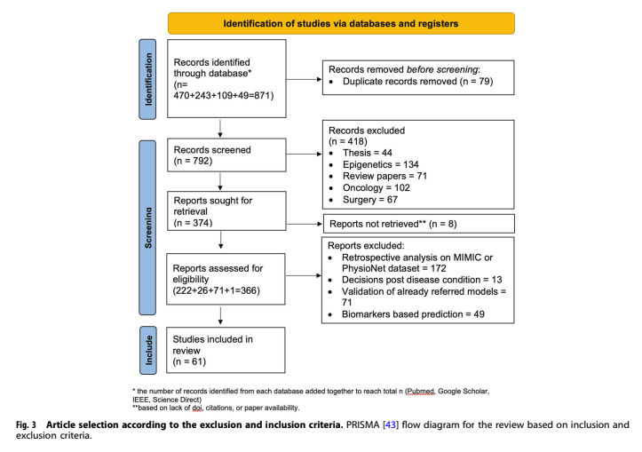
Methodology and Hypothesis
The systematic review follows the Preferred Reporting Items for Systematic Reviews and Meta-Analyses (PRISMA) protocol and includes neonatal studies related to the prediction of morbidities, mortality, or LOS.
Hypothesis 1: whether models utilizing multiple data categories would perform better than models using a single data category.
Hypothesis 2: whether the model was dynamic in nature, meaning whether the model can improve with more data.

Slide 5
Results
Hypothesis 1:
The text mentions that the comparison with respect to this hypothesis was not feasible for Length of Stay (LOS) studies because all LOS studies had a single data source.
Hypothesis 2:
The text suggests that the static models had an average reported Receiver Operating Characteristic (ROC) of 89.9%, compared to 88% in dynamic models.
ML-based models, which primarily used three data sources, were noted to be limited by recurrent missingness in medical data, explaining the lower ROC of 87%.
While the text provides information on the average reported ROC scores for different types of models and data sources, it does not explicitly state whether the hypotheses were accepted or rejected.

Slide 6
Current Limitations/Gaps:
Regression Models and Metric Variations:
Most models use linear regression despite the nonlinear nature of physiological data.
Variation in performance metrics hinders direct model comparisons.
Missing Data and Privacy Issues:
Neonatal time series data is often missing during various NICU activities.
Privacy concerns limit the sharing of clinical care data between NICUs.
Device and Code Repository Limitations:
Lack of standardized protocols, technology, and alarm settings in different NICUs.
Code repositories for prediction scores are not peer-reviewed.

Slide 7
Challenges and Future Directions:
Complete Phenotype Data:
Current research often focuses on individual diseases or organ systems, lacking complete neonatal phenotype data.
Noise in NICU Data:
Routine NICU data is noisy, impacting the quality of ML model training.
Interdisciplinary Commitment:
Successful AI projects in the NICU require collaboration among multiple stakeholders, including ethics teams, engineers, informaticists, and clinical providers.
Incorporating Environmental Data:
Limited use of environmental NICU parameters in prediction models, such as bedside lighting, sound conditions, neonatal handling, and video data.

Slide 8
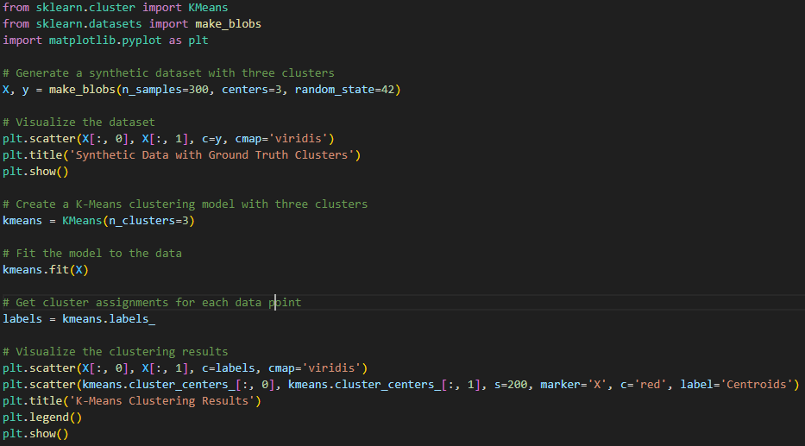
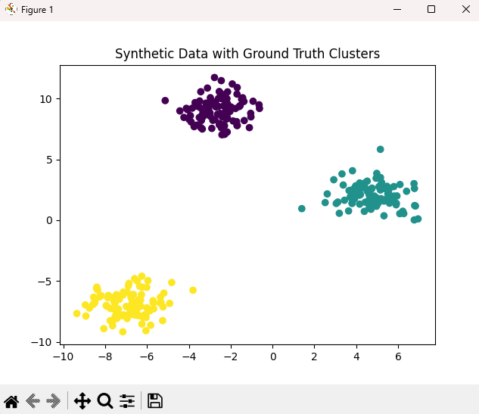
Sk_learn Python

